Slide 1

WIPRO NGA Program – Java Full Stack 25VID1947
Capstone Project Presentation – 29 August
Project Title Here – Task Management System
Presented by – Chaithanya Kumar Reddy Kakarla
www.rpsconsulting.in

Slide 2

Introduction / Problem Statement
• Task management is crucial for productivity
• Without a proper system, tasks become unorganized
• Leads to missed deadlines and inefficiency
2025 - RPS Consulting all rights reserved

Slide 3
Objectives
• Organize tasks effectively
• Assign tasks to users
• Track status & deadlines
• Improve productivity
2025 - RPS Consulting all rights reserved

Slide 4
System Architecture Overview
• Frontend: Angular (Task-Management)
• Backend: Spring Boot (TaskManagement)
• Database: MySQL
• Tools: GitHub, Jenkins, Docker, Kubernetes
2025 - RPS Consulting all rights reserved

Slide 5
Key Features
• User Authentication (Login/Register)
• Create / Update / Delete Tasks
• Task Assignment & Status Tracking
• Duedate
2025 - RPS Consulting all rights reserved

Slide 6
Tech Stack
• Frontend: Angular, HTML, CSS, TypeScript
• Backend: Spring Boot, Java, REST APIs
• Database: MySQL
• DevOps: GitHub, Jenkins, Docker, Kubernetes
2025 - RPS Consulting all rights reserved

Slide 7
CI/CD Workflow
Push code → GitHub
2. Jenkins Build & Test
3. Docker Image Creation
4. Deploy on Kubernetes
2025 - RPS Consulting all rights reserved

Slide 8
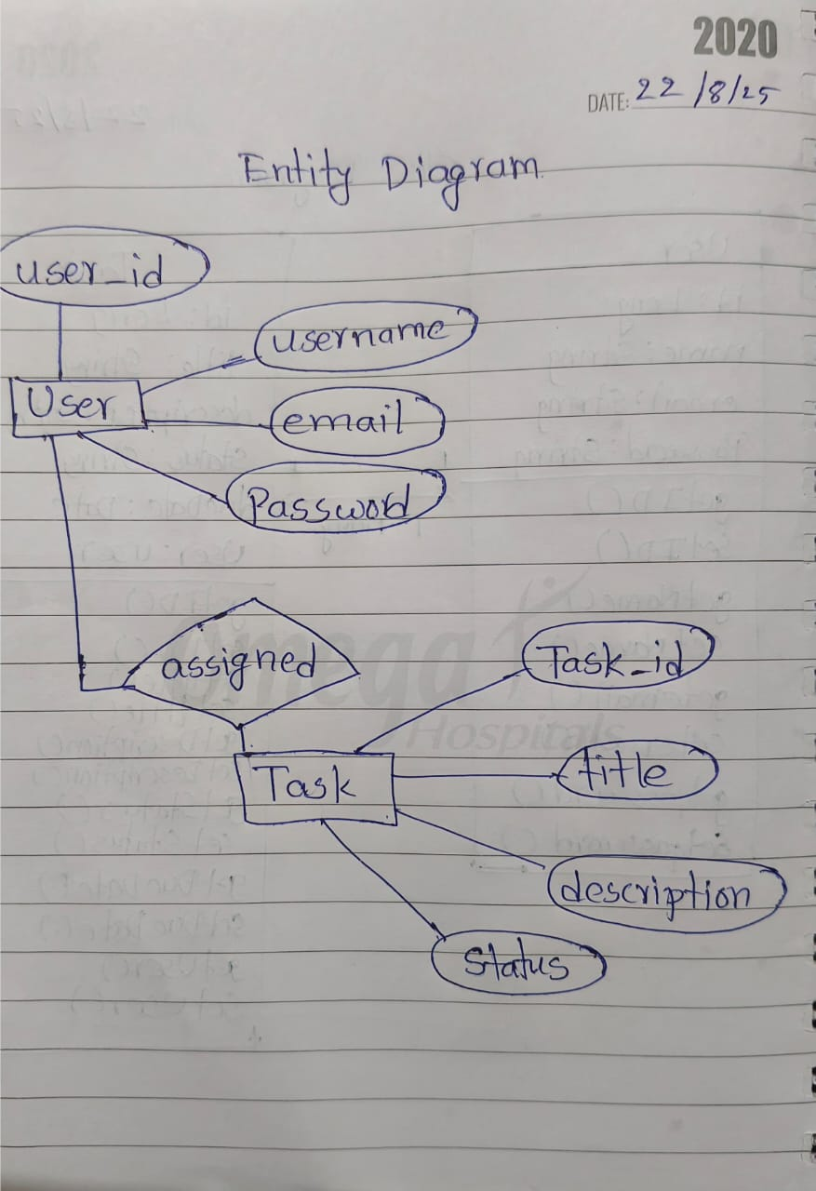
Entity Relationship Diagram
Slide details here
2025 - RPS Consulting all rights reserved

Slide 9
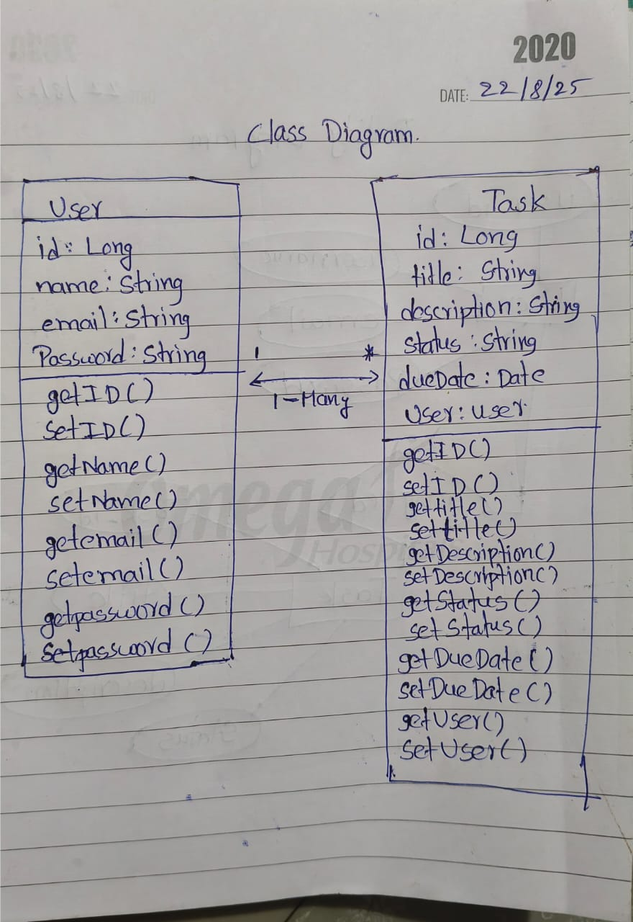
Class Diagram
Slide details here
2025 - RPS Consulting all rights reserved

Slide 10
Conclusion
• Provides efficient task management
• Improves team productivity
• Scalable with CI/CD & Kubernetes
2025 - RPS Consulting all rights reserved

